Slide 1
Design Challenge 3
Team 45
Kathryn Atherton
Joshua Hahn
Hannah Mackin Schenck

Slide 2
Device Function
Customer Need | Technical Need | Technical Requirement | Target Value
Turns on/off after 3 claps | Times out of 10 claps are detected correctly | 9/10 trials work correctly | 10/10 trials work correctly
Sense a variety of clap vibrations | Vibration Intensity detected | Above the threshold of 30 | Above the threshold of 30
“Clapper” light switch
Vibration sensor detects vibrations due to clapping and turns on or off and LED light depending on its current state.
Arduino reads in input values from vibration sensor.
If above a certain threshold, and if three acceptable inputs in a row, Arduino changes current state of LED

Slide 3
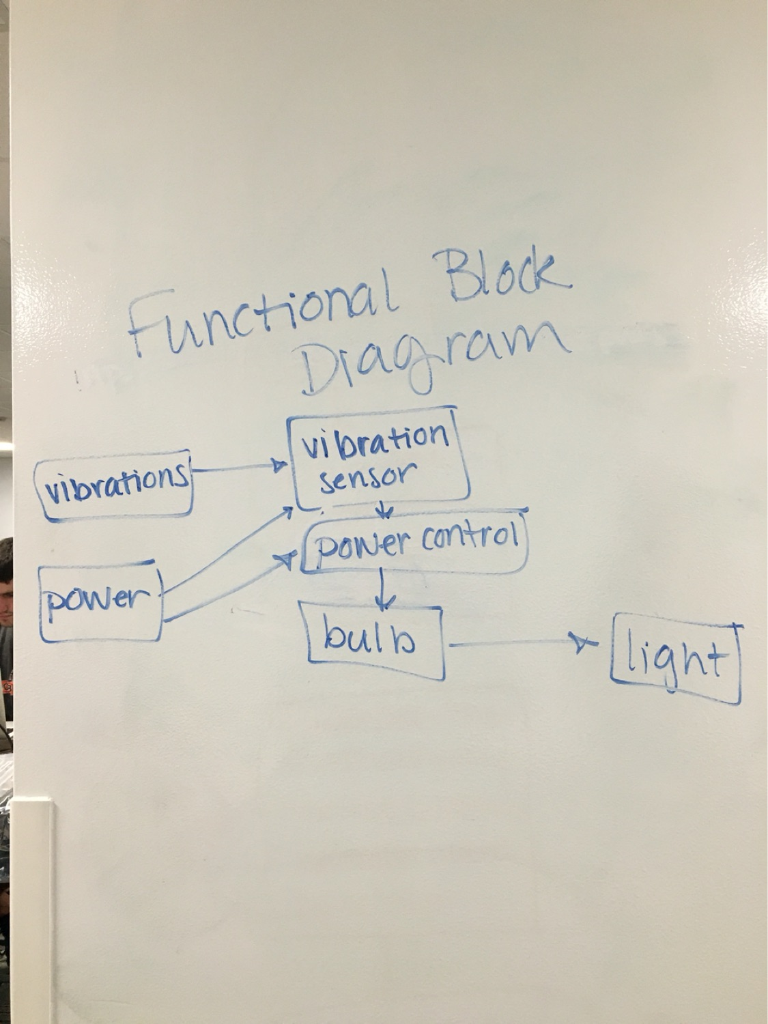
System Diagram

Slide 4
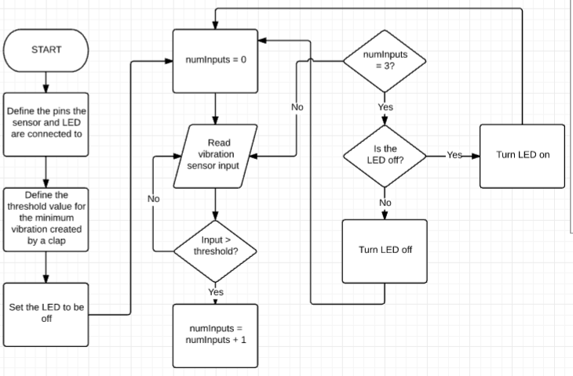
Conceptual Logic Flowchart

Slide 5
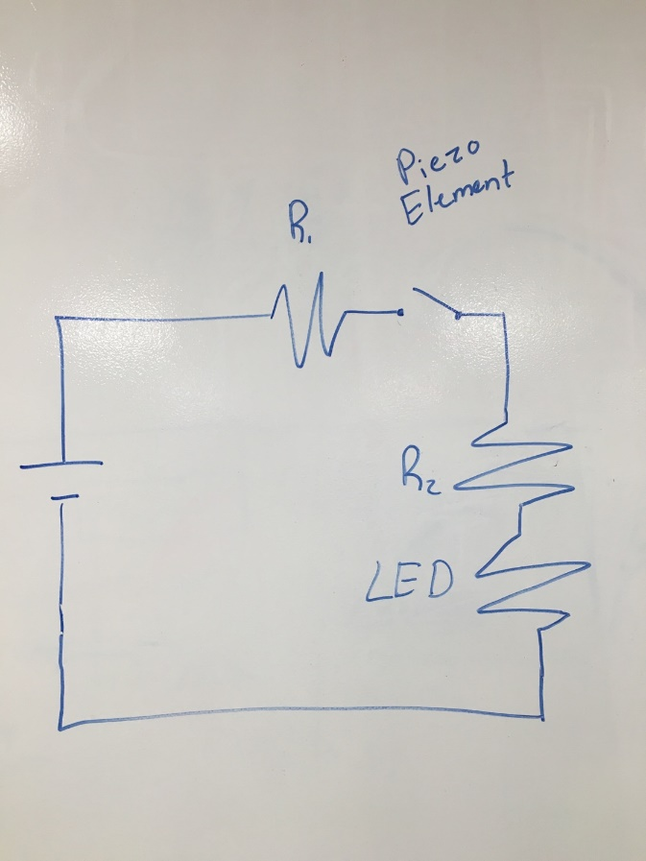
Prototype Circuit Design

Slide 6
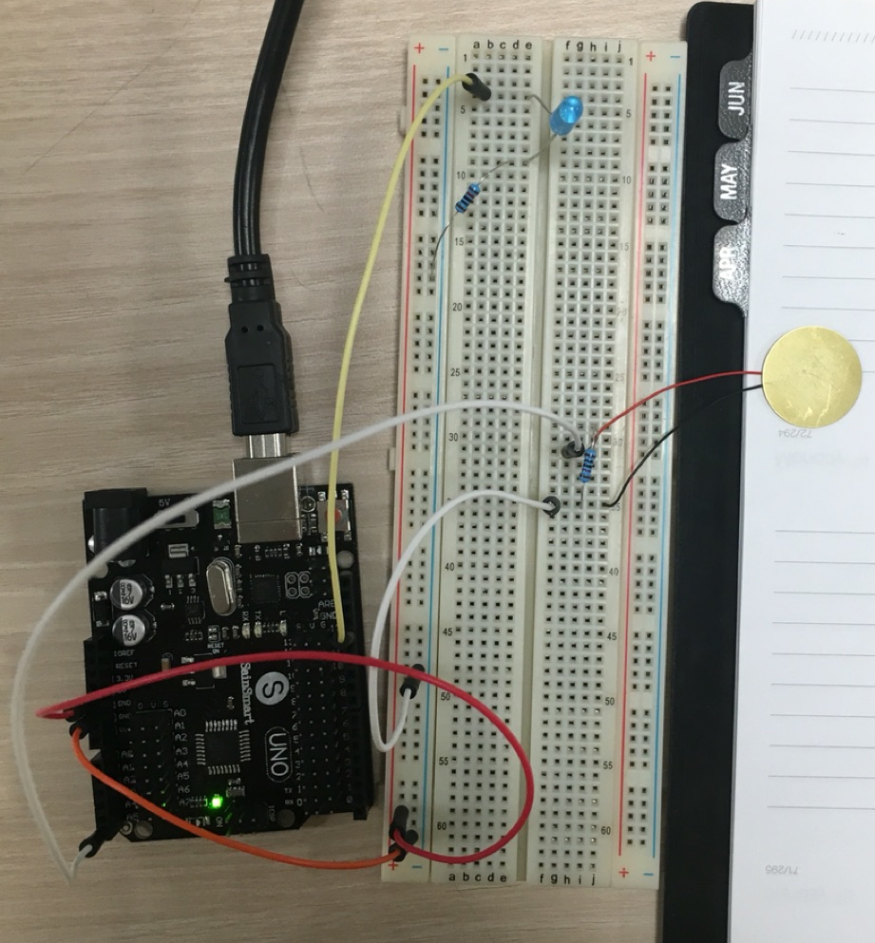
Image of Circuit

Slide 7
Test Results
TESTING ROUND | THRESHOLD VALUE | OBSERVATIONS
1 | 100 | LED only turned on if breadboard itself is knocked. Not sensitive to vibrations close to breadboard
2 | 50 | LED turned on when the vibration sensor is lightly tapped, but still not sensitive enough to detect clapping vibrations
3 | 5 | LED turned on after only two taps. Too sensitive to knocks.
4 | 30 | LED turned on much more consistently. Does not detect claps, as originally planned, but works consistently with knocks or taps to the vibration sensor

Slide 8
Discussion
Future steps to work with claps rather than taps/knocks:
Set very low threshold and a maximum threshold to prevent very non-clapping vibrations from causing errors to the system (i.e. door slams, bumps)
Other ideas for this design:
Increase the amount of light for every tap detected
Use multiple LED lights
Use this to control the amount of light coming from the flashlight/nightlight/room/etc. depending on the amount of claps/taps detected

Slide 9
Thank You
Questions?

